Slide 1


Control Flow
Chris Piech
CS106A, Stanford University

Slide 2

CS106A

Slide 3


Karel the Robot
s
* While Karel is in Java, when you program your Karel assignment we ask that you stick to the concepts in the course reader
Notes:
Tomorrow you will learn that Karel is actually a very gentle introduction to programming

Slide 4


First Challenge
3
+
+
+
+
2
+
+
+
+
1
+
+
+
+
1
2
3
4

Slide 5
Anatomy of a Program
import stanford.karel.*;
public class OurKarelProgram extends Karel {
public void run() {
move();
pickBeeper();
move();
turnLeft();
move();
turnRight();
move();
putBeeper();
move();
}
private void turnRight() {
turnLeft();
turnLeft();
turnLeft();
}
}
This is the program's source code

Slide 6
Anatomy of a Program
import stanford.karel.*;
public class OurKarelProgram extends Karel {
public void run() {
move();
pickBeeper();
move();
turnLeft();
move();
turnRight();
move();
putBeeper();
move();
}
private void turnRight() {
turnLeft();
turnLeft();
turnLeft();
}
}
This piece of the program's source code is called a method.

Slide 7
Anatomy of a Program
import stanford.karel.*;
public class OurKarelProgram extends Karel {
public void run() {
move();
pickBeeper();
move();
turnLeft();
move();
turnRight();
move();
putBeeper();
move();
}
private void turnRight() {
turnLeft();
turnLeft();
turnLeft();
}
}
x
This line of code gives the name of the method
(here, run)

Slide 8
Anatomy of a Program
import stanford.karel.*;
public class OurKarelProgram extends Karel {
public void run() {
move();
pickBeeper();
move();
turnLeft();
move();
turnRight();
move();
putBeeper();
move();
}
private void turnRight() {
turnLeft();
turnLeft();
turnLeft();
}
}
This line of code gives the name of the method
(here, turnRight)

Slide 9
Anatomy of a Program
import stanford.karel.*;
public class OurKarelProgram extends Karel {
public void run() {
move();
pickBeeper();
move();
turnLeft();
move();
turnRight();
move();
putBeeper();
move();
}
private void turnRight() {
turnLeft();
turnLeft();
turnLeft();
}
}
This is called an import statement. It tells Java what Karel is.

Slide 10
Anatomy of a Program
import stanford.karel.*;
public class OurKarelProgram extends Karel {
public void run() {
move();
pickBeeper();
move();
turnLeft();
move();
turnRight();
move();
putBeeper();
move();
}
private void turnRight() {
turnLeft();
turnLeft();
turnLeft();
}
}
This is called a code block

Slide 11
Anatomy of a Program
import stanford.karel.*;
public class OurKarelProgram extends Karel {
public void run() {
move();
pickBeeper();
move();
turnLeft();
move();
turnRight();
move();
putBeeper();
move();
}
private void turnRight() {
turnLeft();
turnLeft();
turnLeft();
}
}

Slide 12
Anatomy of a Program
import stanford.karel.*;
public class OurKarelProgram extends Karel {
public void run() {
move();
pickBeeper();
move();
turnLeft();
move();
turnRight();
move();
putBeeper();
move();
}
private void turnRight() {
turnLeft();
turnLeft();
turnLeft();
}
}

Slide 13
Anatomy of a Program
import stanford.karel.*;
public class OurKarelProgram extends Karel {
public void run() {
move();
pickBeeper();
move();
turnLeft();
move();
turnRight();
move();
putBeeper();
move();
}
private void turnRight() {
turnLeft();
turnLeft();
turnLeft();
}
}

Slide 14
Anatomy of a Program
import stanford.karel.*;
public class OurKarelProgram extends Karel {
public void run() {
move();
pickBeeper();
move();
turnLeft();
move();
turnRight();
move();
putBeeper();
move();
}
private void turnRight() {
turnLeft();
turnLeft();
turnLeft();
}
}

Slide 15
Anatomy of a Program
import stanford.karel.*;
public class OurKarelProgram extends Karel {
public void run() {
move();
pickBeeper();
move();
turnLeft();
move();
turnRight();
move();
putBeeper();
move();
}
private void turnRight() {
turnLeft();
turnLeft();
turnLeft();
}
}
The run method is “public” so that Eclipse can call it.

Slide 16
Anatomy of a Program
import stanford.karel.*;
public class OurKarelProgram extends Karel {
public void run() {
move();
pickBeeper();
move();
turnLeft();
move();
turnRight();
move();
putBeeper();
move();
}
private void turnRight() {
turnLeft();
turnLeft();
turnLeft();
}
}
The turnRight method is “private” to indicate it is only visible to our current program.

Slide 17

Notes:
Show reloading Karel

Slide 18
Method Definition
private void name() {
statements in the method body
}
This adds a new command to Karels vocabulary

Slide 19
For loops,
While loops,
If/Else statements

Slide 20
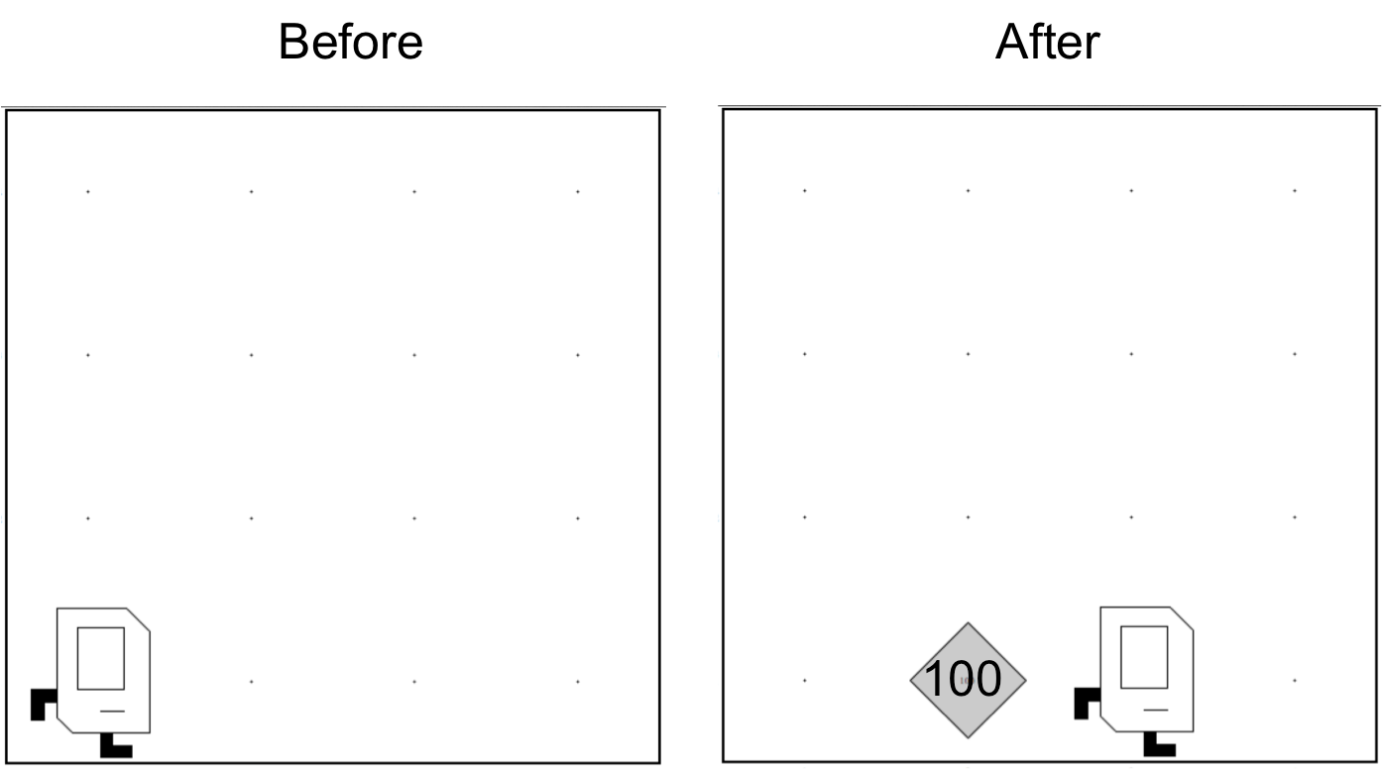
Place 99 beepers?
99

Slide 21
Place 99 beepers
public class Place99Beepers extends SuperKarel {
public void run() {
move();
for(int i = 0; i < 99; i++) {
putBeeper();
}
move();
}
}
This “for loop” repeats the code in its “body” 99 times

Slide 22

Place Beeper Square
public class BeeperSquare extends SuperKarel {
public void run() {
for(int i = 0; i < 4; i++) {
putBeeper();
move();
turnLeft();
}
}
}

Slide 23
Place Beeper Square
public class BeeperSquare extends SuperKarel {
public void run() {
for(int i = 0; i < 4; i++) {
putBeeper();
move();
turnLeft();
}
}
}
First time through the loop

Slide 24

Place Beeper Square
public class BeeperSquare extends SuperKarel {
public void run() {
for(int i = 0; i < 4; i++) {
putBeeper();
move();
turnLeft();
}
}
}
First time through the loop

Slide 25
Place Beeper Square
public class BeeperSquare extends SuperKarel {
public void run() {
for(int i = 0; i < 4; i++) {
putBeeper();
move();
turnLeft();
}
}
}
First time through the loop

Slide 26
Place Beeper Square
public class BeeperSquare extends SuperKarel {
public void run() {
for(int i = 0; i < 4; i++) {
putBeeper();
move();
turnLeft();
}
}
}
First time through the loop

Slide 27
Place Beeper Square
public class BeeperSquare extends SuperKarel {
public void run() {
for(int i = 0; i < 4; i++) {
putBeeper();
move();
turnLeft();
}
}
}
Second time through the loop

Slide 28
Place Beeper Square
public class BeeperSquare extends SuperKarel {
public void run() {
for(int i = 0; i < 4; i++) {
putBeeper();
move();
turnLeft();
}
}
}
Second time through the loop

Slide 29
Place Beeper Square
public class BeeperSquare extends SuperKarel {
public void run() {
for(int i = 0; i < 4; i++) {
putBeeper();
move();
turnLeft();
}
}
}
Second time through the loop

Slide 30
Place Beeper Square
public class BeeperSquare extends SuperKarel {
public void run() {
for(int i = 0; i < 4; i++) {
putBeeper();
move();
turnLeft();
}
}
}
Second time through the loop

Slide 31
Place Beeper Square
public class BeeperSquare extends SuperKarel {
public void run() {
for(int i = 0; i < 4; i++) {
putBeeper();
move();
turnLeft();
}
}
}
Third time through the loop

Slide 32
Place Beeper Square
public class BeeperSquare extends SuperKarel {
public void run() {
for(int i = 0; i < 4; i++) {
putBeeper();
move();
turnLeft();
}
}
}
Third time through the loop

Slide 33
Place Beeper Square
public class BeeperSquare extends SuperKarel {
public void run() {
for(int i = 0; i < 4; i++) {
putBeeper();
move();
turnLeft();
}
}
}
Third time through the loop

Slide 34
Place Beeper Square
public class BeeperSquare extends SuperKarel {
public void run() {
for(int i = 0; i < 4; i++) {
putBeeper();
move();
turnLeft();
}
}
}
Third time through the loop

Slide 35
Place Beeper Square
public class BeeperSquare extends SuperKarel {
public void run() {
for(int i = 0; i < 4; i++) {
putBeeper();
move();
turnLeft();
}
}
}
Fourth time through the loop

Slide 36
Place Beeper Square
public class BeeperSquare extends SuperKarel {
public void run() {
for(int i = 0; i < 4; i++) {
putBeeper();
move();
turnLeft();
}
}
}
Fourth time through the loop

Slide 37
Place Beeper Square
public class BeeperSquare extends SuperKarel {
public void run() {
for(int i = 0; i < 4; i++) {
putBeeper();
move();
turnLeft();
}
}
}
Fourth time through the loop

Slide 38
Place Beeper Square
public class BeeperSquare extends SuperKarel {
public void run() {
for(int i = 0; i < 4; i++) {
putBeeper();
move();
turnLeft();
}
}
}
Fourth time through the loop

Slide 39
Place Beeper Square
public class BeeperSquare extends SuperKarel {
public void run() {
for(int i = 0; i < 4; i++) {
putBeeper();
move();
turnLeft();
}
}
}

Slide 40
Exciting!

Slide 41

Aside: Super Karel
import stanford.karel.*;
public class BeeperLine extends SuperKarel {
public void run() {
// super karel has a few more commands
turnRight();
turnAround();
paintCorner(BLUE);
putBeeper();
move();
}
}

Slide 42
Next task

Slide 43
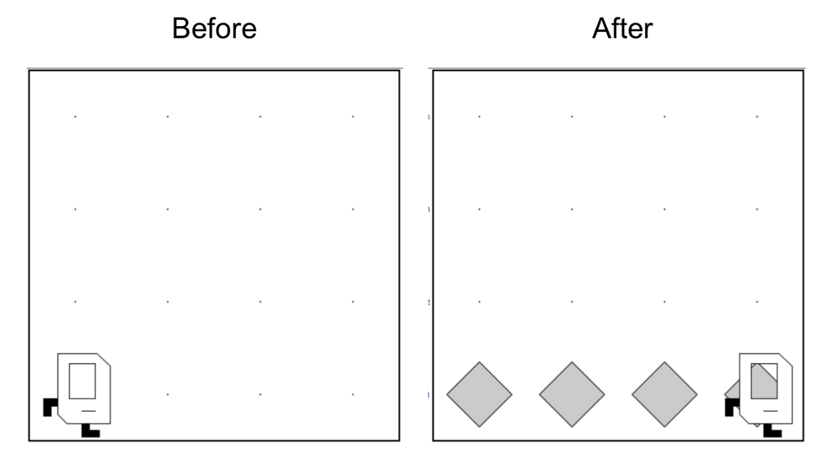
Place Beeper Line

Slide 44
Place Beeper Line
import stanford.karel.*;
public class BeeperLine extends SuperKarel {
public void run() {
for(int i = 0; i < 4; i++) {
putBeeper();
move();
}
}
}

Slide 45


Slide 46

Place Beeper Line
import stanford.karel.*;
public class BeeperLine extends SuperKarel {
public void run() {
for(int i = 0; i < 4; i++) {
putBeeper();
move();
}
}
}

Slide 47


Slide 48

Place Beeper Line
import stanford.karel.*;
public class BeeperLine extends SuperKarel {
public void run() {
for(int i = 0; i < 4; i++) {
putBeeper();
move();
}
}
}
What we want

Slide 49
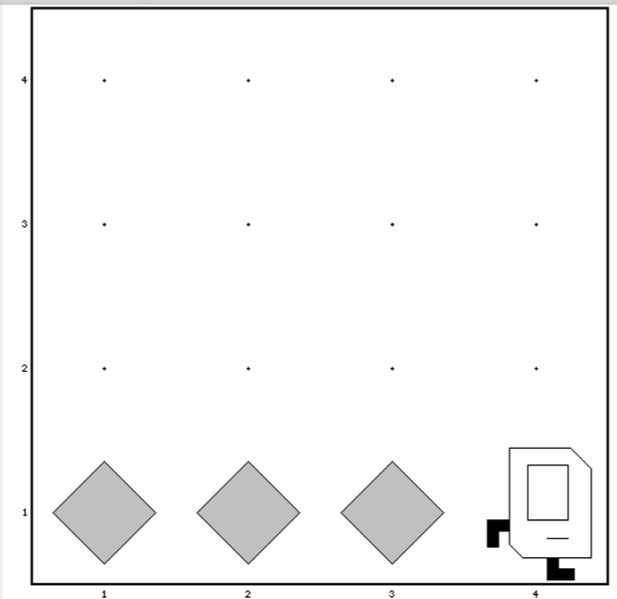
Place Beeper Line
import stanford.karel.*;
public class BeeperLine extends SuperKarel {
public void run() {
for(int i = 0; i < 3; i++) {
putBeeper();
move();
}
}
}

Slide 50

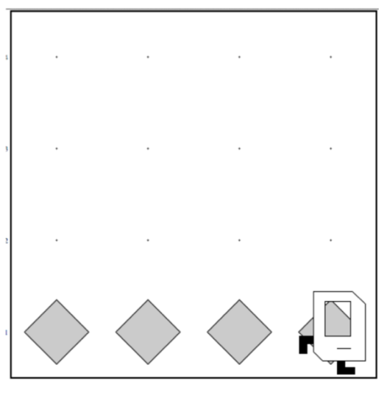
Place Beeper Line
import stanford.karel.*;
public class BeeperLine extends SuperKarel {
public void run() {
for(int i = 0; i < 3; i++) {
putBeeper();
move();
}
// extra put beeper
putBeeper();
}
}

Slide 51
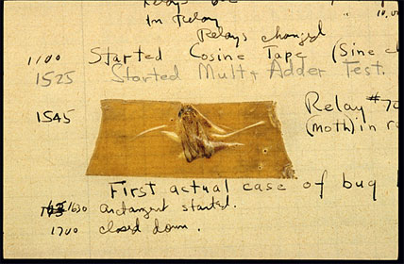
Actual Bug from Mark II Computer
Actual Bug from Marc II

Slide 52
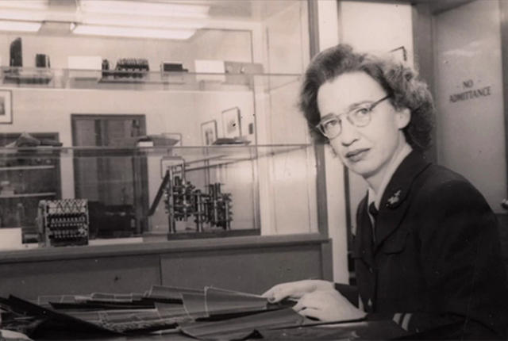
Grace Hopper

Slide 53
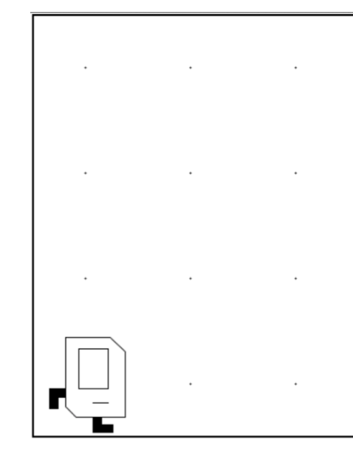
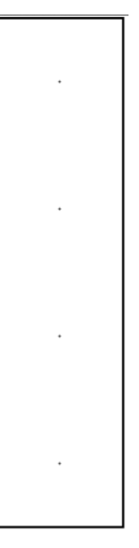
Don’t Know World Size
?

Slide 54
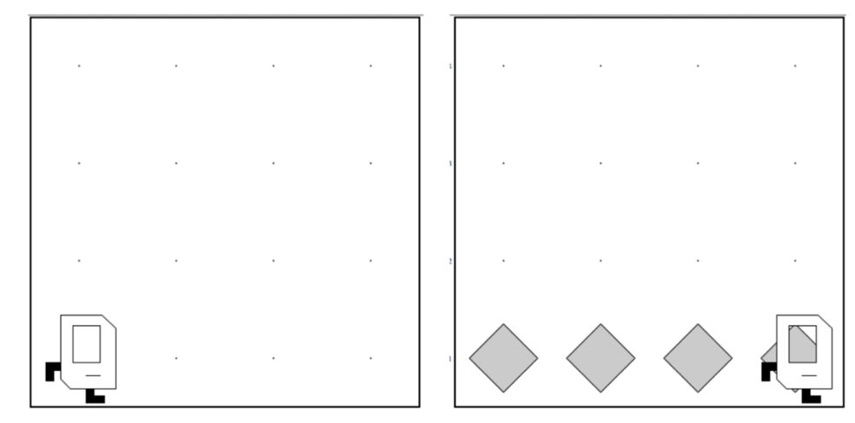
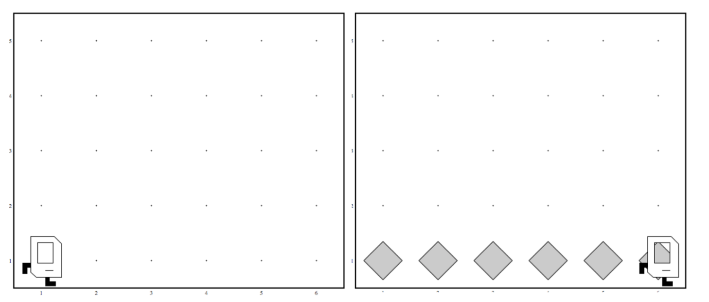
Work in Any World
Before
After
Before
After

Slide 55
While Loop

Slide 56
While Loop
import stanford.karel.*;
public class BeeperLine extends SuperKarel {
public void run() {
// example while loop
while(condition) {
code to repeat
}
}
}

Slide 57
Place Beeper Line
import stanford.karel.*;
public class BeeperLine extends SuperKarel {
public void run() {
// example while loop
while(frontIsClear()) {
move();
}
// extra put beeper
putBeeper();
}
}

Slide 58
Place Beeper Line
import stanford.karel.*;
public class BeeperLine extends SuperKarel {
public void run() {
// example while loop
while(frontIsClear()) {
putBeeper();
move();
}
// extra put beeper
putBeeper();
}
}

Slide 59
Place Beeper Line
import stanford.karel.*;
public class BeeperLine extends SuperKarel {
public void run() {
// example while loop
while(frontIsClear()) {
putBeeper();
move();
}
// extra put beeper
putBeeper();
}
}

Slide 60
Place Beeper Line
import stanford.karel.*;
public class BeeperLine extends SuperKarel {
public void run() {
// example while loop
while(frontIsClear()) {
putBeeper();
move();
}
// extra put beeper
putBeeper();
}
}

Slide 61
Place Beeper Line
import stanford.karel.*;
public class BeeperLine extends SuperKarel {
public void run() {
// example while loop
while(frontIsClear()) {
putBeeper();
move();
}
// extra put beeper
putBeeper();
}
}

Slide 62
Place Beeper Line
import stanford.karel.*;
public class BeeperLine extends SuperKarel {
public void run() {
// example while loop
while(frontIsClear()) {
putBeeper();
move();
}
// extra put beeper
putBeeper();
}
}

Slide 63
Place Beeper Line
import stanford.karel.*;
public class BeeperLine extends SuperKarel {
public void run() {
// example while loop
while(frontIsClear()) {
putBeeper();
move();
}
// extra put beeper
putBeeper();
}
}

Slide 64
Place Beeper Line
import stanford.karel.*;
public class BeeperLine extends SuperKarel {
public void run() {
// example while loop
while(frontIsClear()) {
putBeeper();
move();
}
// extra put beeper
putBeeper();
}
}

Slide 65
Place Beeper Line
import stanford.karel.*;
public class BeeperLine extends SuperKarel {
public void run() {
// example while loop
while(frontIsClear()) {
putBeeper();
move();
}
// extra put beeper
putBeeper();
}
}

Slide 66
Place Beeper Line
import stanford.karel.*;
public class BeeperLine extends SuperKarel {
public void run() {
// example while loop
while(frontIsClear()) {
putBeeper();
move();
}
// extra put beeper
putBeeper();
}
}

Slide 67
Place Beeper Line
import stanford.karel.*;
public class BeeperLine extends SuperKarel {
public void run() {
// example while loop
while(frontIsClear()) {
putBeeper();
move();
}
// extra put beeper
putBeeper();
}
}

Slide 68
Place Beeper Line
import stanford.karel.*;
public class BeeperLine extends SuperKarel {
public void run() {
// example while loop
while(frontIsClear()) {
putBeeper();
move();
}
// extra put beeper
putBeeper();
}
}

Slide 69
Place Beeper Line
import stanford.karel.*;
public class BeeperLine extends SuperKarel {
public void run() {
// example while loop
while(frontIsClear()) {
putBeeper();
move();
}
// extra put beeper
putBeeper();
}
}

Slide 70
Place Beeper Line
import stanford.karel.*;
public class BeeperLine extends SuperKarel {
public void run() {
// example while loop
while(frontIsClear()) {
putBeeper();
move();
}
// extra put beeper
putBeeper();
}
}

Slide 72
Common misconception:

Slide 73
Place Beeper Line: Redux
import stanford.karel.*;
public class BeeperLine extends SuperKarel {
public void run() {
// place a first beeper
putBeeper();
// example while loop
while(frontIsClear()) {
move();
putBeeper();
}
}
}

Slide 74
Place Beeper Line: Redux
import stanford.karel.*;
public class BeeperLine extends SuperKarel {
public void run() {
// place a first beeper
putBeeper();
// example while loop
while(frontIsClear()) {
move();
putBeeper();
}
}
}

Slide 75
Place Beeper Line: Redux
import stanford.karel.*;
public class BeeperLine extends SuperKarel {
public void run() {
// place a first beeper
putBeeper();
// example while loop
while(frontIsClear()) {
move();
putBeeper();
}
}
}

Slide 76
Place Beeper Line: Redux
import stanford.karel.*;
public class BeeperLine extends SuperKarel {
public void run() {
// place a first beeper
putBeeper();
// example while loop
while(frontIsClear()) {
move();
putBeeper();
}
}
}

Slide 77
Place Beeper Line: Redux
import stanford.karel.*;
public class BeeperLine extends SuperKarel {
public void run() {
// place a first beeper
putBeeper();
// example while loop
while(frontIsClear()) {
move();
putBeeper();
}
}
}

Slide 78
Place Beeper Line: Redux
import stanford.karel.*;
public class BeeperLine extends SuperKarel {
public void run() {
// place a first beeper
putBeeper();
// example while loop
while(frontIsClear()) {
move();
putBeeper();
}
}
}

Slide 79
Place Beeper Line: Redux
import stanford.karel.*;
public class BeeperLine extends SuperKarel {
public void run() {
// place a first beeper
putBeeper();
// example while loop
while(frontIsClear()) {
move();
putBeeper();
}
}
}

Slide 80
Place Beeper Line: Redux
import stanford.karel.*;
public class BeeperLine extends SuperKarel {
public void run() {
// place a first beeper
putBeeper();
// example while loop
while(frontIsClear()) {
move();
putBeeper();
}
}
}

Slide 81
Place Beeper Line: Redux
import stanford.karel.*;
public class BeeperLine extends SuperKarel {
public void run() {
// place a first beeper
putBeeper();
// example while loop
while(frontIsClear()) {
move();
putBeeper();
}
}
}
This is incredibly important!

Slide 82
Place Beeper Line: Redux
import stanford.karel.*;
public class BeeperLine extends SuperKarel {
public void run() {
// place a first beeper
putBeeper();
// example while loop
while(frontIsClear()) {
move();
putBeeper();
}
}
}

Slide 83
Place Beeper Line: Redux
import stanford.karel.*;
public class BeeperLine extends SuperKarel {
public void run() {
// place a first beeper
putBeeper();
// example while loop
while(frontIsClear()) {
move();
putBeeper();
}
}
}

Slide 84
Place Beeper Line: Redux
import stanford.karel.*;
public class BeeperLine extends SuperKarel {
public void run() {
// place a first beeper
putBeeper();
// example while loop
while(frontIsClear()) {
move();
putBeeper();
}
}
}

Slide 85
Place Beeper Line: Redux
import stanford.karel.*;
public class BeeperLine extends SuperKarel {
public void run() {
// place a first beeper
putBeeper();
// example while loop
while(frontIsClear()) {
move();
putBeeper();
}
}
}

Slide 86
Which Loop
Repeat Process
Know how many times
Don’t know how many times
For Loop
While Loop

Slide 87
What if you only want to repeat one time?

Slide 88
If statement

Slide 89
If Statement
import stanford.karel.*;
public class IfExample extends SuperKarel {
public void run() {
// example of an if statement
if(condition) {
code to run if condition is true
}
}
}

Slide 90
If Statement
import stanford.karel.*;
public class IfExample extends Pretend{
public void run() {
// example of an if statement
if(youLikeBeyonce()) {
makeSomeNoise();
}
}
}

Slide 91
If Statement
import stanford.karel.*;
public class IfExample extends SuperKarel{
public void run() {
safeMove();
}
private void safeMove() {
if(frontIsClear()) {
move();
}
}
}

Slide 92
If / Else Statement
import stanford.karel.*;
public class IfExample extends SuperKarel{
public void run() {
invertBeeper();
}
private void invertBeeper() {
if(beepersPresent()) {
pickBeeper();
} else {
putBeeper();
}
}
}

Slide 93
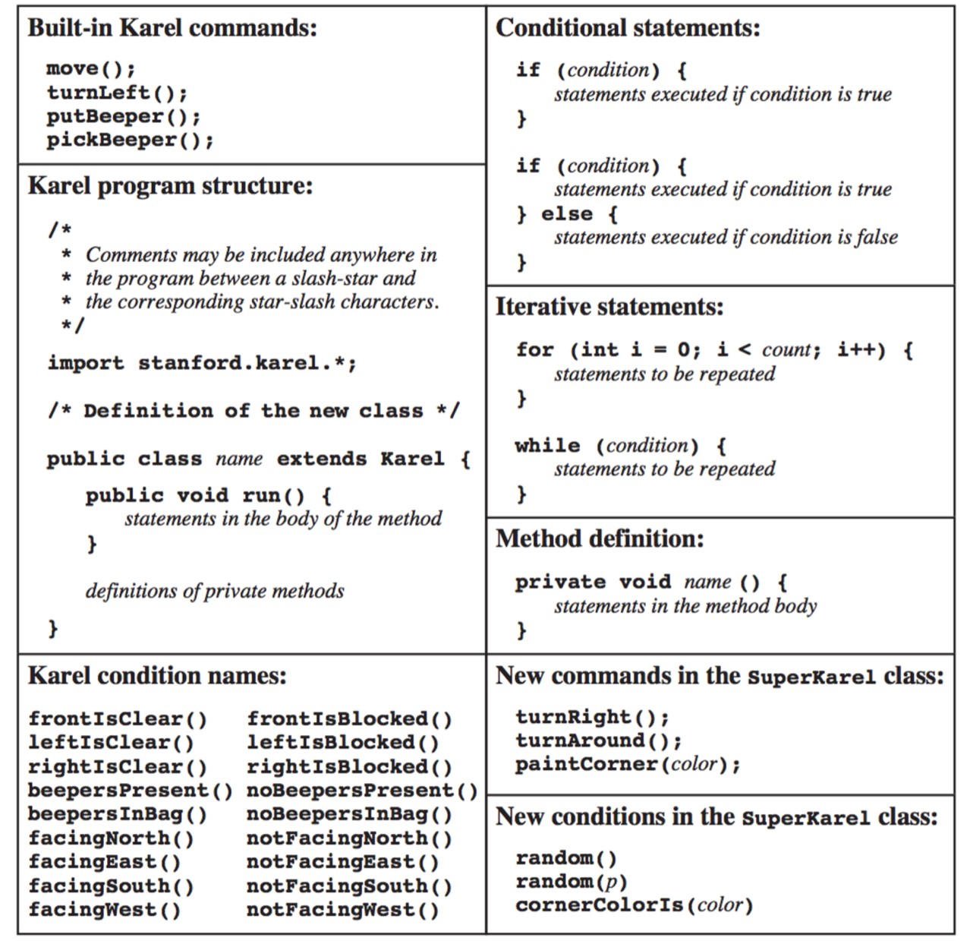
The Full Karel

Slide 94
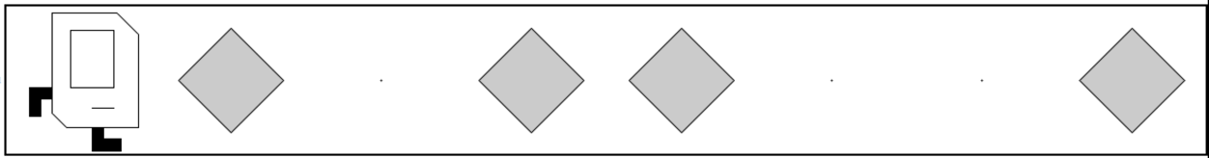
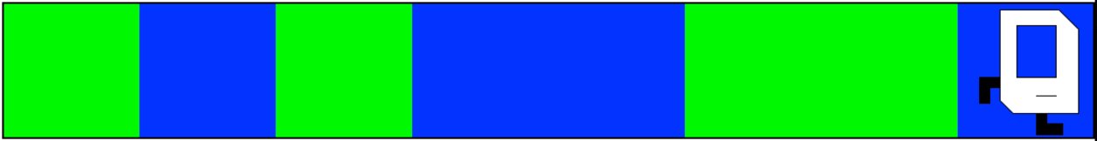
Random Painter
Before:
After:
Before:
After:

Slide 95
You just learned most of programming “control flow”

